Slide 1
Cornell Cooperative Extension NYS
About Positive youth development
Volunteer Orientation
CCE provides equal program and employment opportunities. Please contact Cornell Cooperative Extension if you have any special needs.

Slide 2
The 4-H Way
4-H is a model program

Slide 3
About 4-H
4‑H is America’s largest youth development organization, empowering nearly six million young people with the skills to lead for a lifetime.
Learn more about 4-H HERE https://4-h.org/about/
“In 4‑H, we believe in the power of young people. We see that every child has valuable strengths and real influence to improve the world around us”.

Slide 4
What 4-H in NYS Does
In 4-H programs, kids and teens complete hands-on projects in areas like health, science, agriculture, and civic engagement in a positive environment where they receive guidance from adult mentors and are encouraged to take on proactive leadership roles.

Slide 5
CCE Embraces Inclusivity
No person shall be denied admission to any educational program or activity or be denied employment (with CCE) on the basis of any legally prohibited discrimination involving, but not limited to, such factors as race, color, religion, political beliefs, national or ethnic origin, gender, sexual orientation, age, marital or family status, veteran status, or disability. CCE is an Equal Opportunity Employer and Program Provider and invites all those with special needs to contact us regarding those needs that we may arrange for services.
CCE statement on diversity, equity and inclusion
Notes:
Diversity and Inclusivity is particularly important to us.

Slide 6
4-H is for ALL Young People
In Dutchess County we take a
zero tolerance
policy towards any form of discrimination, bullying or harassment

Slide 7
Definition of Education
Education is about the learner making choices
Nobody can be an educator unless the student chooses to be educated
“Education: the knowledge and development resulting from the process of being educated”
https://www.merriam-webster.com/dictionary/education

Slide 8
4-H is Non-formal Education
Non-formal learning takes place outside formal learning environments but within some kind of organisational framework. It arises from the learner's conscious decision to master a particular activity, skill or area of knowledge and is thus the result of intentional effort.
4-H learners need YOU …
to inspire, motivate and support them!
https://www.coe.int/

Slide 9
Theories of Positive Youth Development
Positive Experiences
plus
Positive Relationships
plus
Positive Environments
https://youth.gov

Slide 10
Positive Youth Development (PYD)
ACT for Youth is a partnership among Cornell University Bronfenbrenner Center for Translational Research, Cornell University Cooperative Extension of New York City, and the Division of Adolescent Medicine at the University of Rochester Medical Center. From 2000 to 2017, our partnership also included the Center for School Safety at Ulster BOCES.
Cornell University Bronfenbrenner Center for Translational Research
(BCTR) leads the partnership.
https://actforyouth.net/

Slide 11
Positive Youth Development
“… is an intentional, prosocial approach that ….. enhances youth's strengths and assets”.
“… promotes positive outcomes for young people by providing opportunities, fostering positive relationships, and furnishing the support needed to build on their leadership strengths”.
4-H Volunteers ensure that:
https://actforyouth.net/pyd/
Notes:
Give a sample lesson plan

Slide 12
Youth Outcomes of PYD Done Well
Competence: the ability to act effectively in a range of settings, including social, emotional, cognitive, cultural, health, academic, vocational, and civic domains. | Connection: a sense of belonging, positive bonds with people and social institutions; being protected and having basic needs met.
Confidence: a sense of overall self-worth, mastery, and efficacy; awareness of making progress in life and having expectations for the future; belief in one's ability to make a meaningful contribution. | Character: respect for society and cultural rules; an inner moral compass; taking responsibility and being accountable.
Caring/Compassion: a sense of sympathy and empathy for others, a commitment to social justice. | Contribution: active participation and leadership, bringing about positive change in self, family, social, and civic life.
https://actforyouth.net/

Slide 13
What do we need to Thrive?
Maslow’s hierarchy of needs

Slide 14
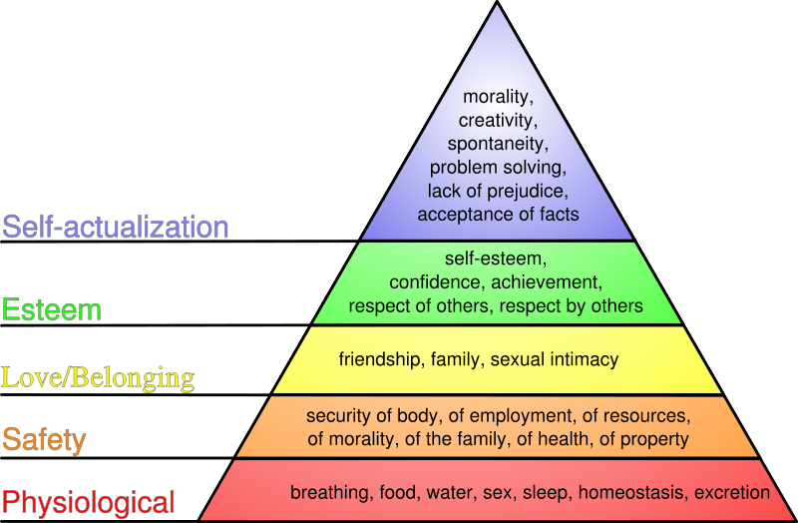
Maslow’s Hierarchy of Needs
E.g., hungry, scared or isolated children cannot develop self-respect and confidence

Slide 15
What makes young people Thrive?
The thriving model

Slide 16
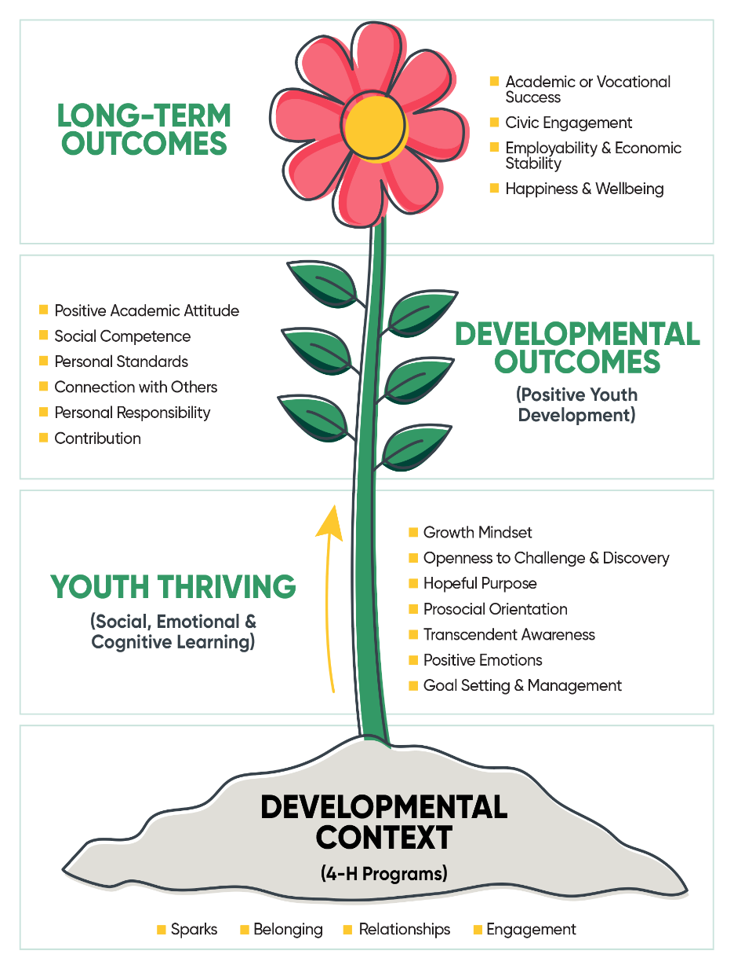
The Thriving Model

Slide 17
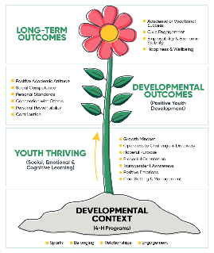
The Thriving Model
The 4-H Thriving Model is the theory of change for positive youth development in 4-H through high quality programs.
7 indicators that show youth are thriving
Openness to challenge and discover
Growth mindset
Hopeful purpose
Pro-social orientation
Transcendent awareness
Positive emotionality
Self-regulation though goal setting and management
https://helping-youth-thrive.extension.org/home/
Notes:
These are some of youth supported by volunteers in your County!

Slide 18
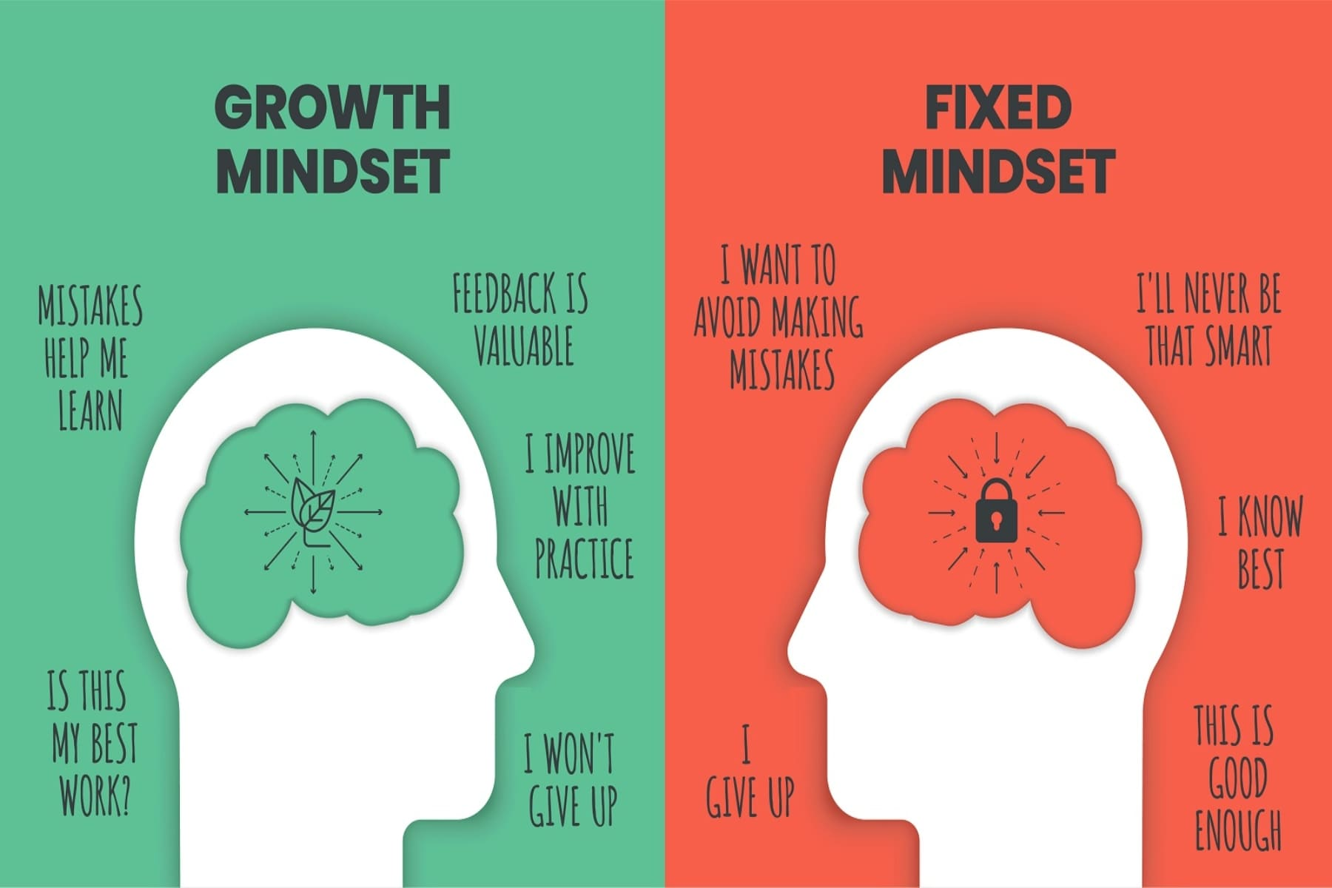
Growth Mindset – help your youth thrive

Slide 19
Great educators: - spark interest - help set goals - plan and begin the journey - support students to maintain progress
The stages of change

Slide 20
No Fire without a Spark
Help kids find their SPARK so that their interest catches on fire!
Sparks provide joy, purpose, and direction.
They come from deep within and provide energy, joy, purpose, and direction in one’s life.

Slide 21
The Stages of Change
Prochaska and DiClemente’s Stages of Change Model
“When a person feels accepted for who they are and what they do – no matter how unhealthy – it allows them the freedom to consider change rather than needing to defend against it”.
Precontemplation
Not thinking about learning/changing
Contemplation
Thinking about learning/changing
Determination
Motivated to learn/change
Action
Engaged in process
Maintenance
The hard part
https://bhdp.sccgov.org/sites/g/files/exjcpb716/files/lp-stages-change-and-trx-for-suts-clinician-ppt-04-11-18.pdf

Slide 22
Add fun and hands-on activities for the kids!
Principles of (adult) learning

Slide 23
Six Principals of Adult Learning … but applicable to children too!
Notes:
Respect: Learn and use learners’ names, greet people at the door, set up materials ahead of time
Inclusion: Introduce people who may not know each other, bring late people up to speed, ensure everyone has resources they need, acknowledge each person during the course of the day/training.
Relevance: Use examples from the participant’s world, use recipes or other teaching tools that are familiar to them, ask for suggestions from participants on possible activities or topics.
30/50/70/90: Include opportunities for the learners to hear, see, and do.
Immediacy: When possible provide opportunities for learners to immediately use the information.
Safety: Ensure that no one is embarrassed by an activity, or forced to reveal personal or private information. Provide choice and respect silence. (refer back to slide that indicates that fear is a key barrier to hearing/listening)

Slide 24
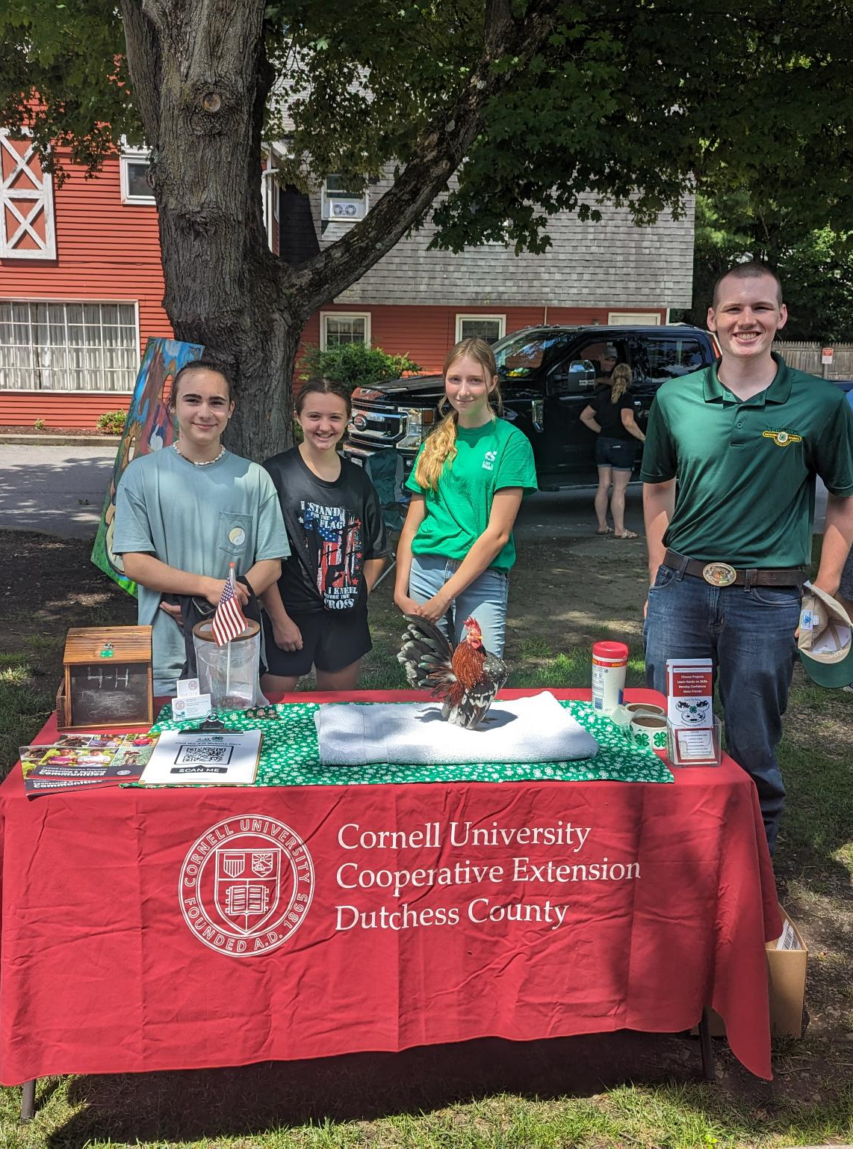
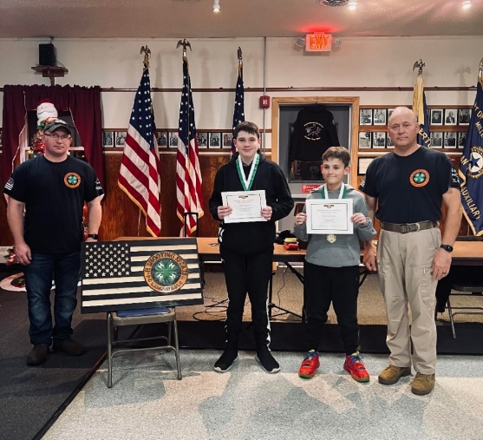
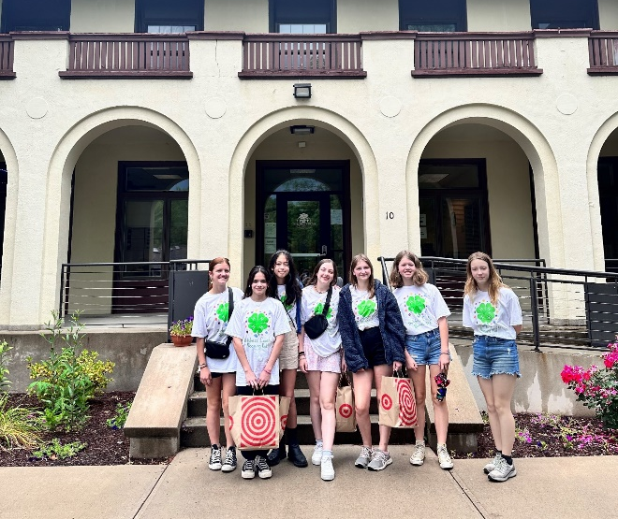
Leading in 4-H is not Work … but does need commitment, skill and thoughtfulness
Notes:
These are some of youth supported by volunteers in your County!

Slide 25
Tips and Tricks for Educating and Mentoring Youth
The following slides provide some basics for you to think about and incorporate into your interactions with the young people we serve and support.
Notes:
Education does not mean throwing information at people and expecting them to learn….
As educators our responsibility is to create a learning environment that helps them take away as much as possible…and sometimes this means finding new ways to deliver our messages
(Give an example of a situation that can be meant in one way and is interpreted in another. For example: e-mail is a style of communication that can be taken different ways depending on how you read it. Think of a teenager and the way they communicate interpret things with arms crossed, eyes rolling and loud sighs)
In addition, consider how the frame of mind you are in will effect the way you interpret what you read or hear…)

Slide 26
Communication is really about the LISTENER
A listening is influenced by:
past experiences
comfort with setting/environment
beliefs (ethnicity, religion)
perceived abilities
confidence vs. fears
values
expectations
Notes:
Education is really about the student and not the teacher….
Provide some examples of 2-3 of the listed items… ie: perceived ability: do you have control of your health or of your environment? Can one person really make a difference?
Your audience may not want to be there, they may have little faith that they or “things” can change, or have other attitudes that will be resistant to hearing your messages.

Slide 27
Communication Styles
It’s not what you say, it’s the way that you say it!
Use a range of communication styles relevant to the situation and group you are working with
Non-verbal vs. Verbal
Positive phasing
Tone conveys meaning
Notes:
Education does not mean throwing information at people and expecting them to learn….
As educators our responsibility is to create a learning environment that helps them take away as much as possible…and sometimes this means finding new ways to deliver our messages
(Give an example of a situation that can be meant in one way and is interpreted in another. For example: e-mail is a style of communication that can be taken different ways depending on how you read it. Think of a teenager and the way they communicate interpret things with arms crossed, eyes rolling and loud sighs)
In addition, consider how the frame of mind you are in will effect the way you interpret what you read or hear…)

Slide 28
Learning Styles
We all have preferred learning styles.
Studies tell us the population identifies as:
60% visual (learn by seeing images)
25% kinesthetic (learn by doing)
15 % auditory (learn through words)
BUT most people can learn in any way if appropriate to activity, motivated and with the right support!
Notes:
Those these are the national numbers on how people prefer to learn… this is not the national numbers when it comes to how people educate… Its almost completely opposite. i.e.: lecture halls

Slide 29
Identify Barriers and Resolve Issues that prevent youth from learning
Possible reasons:
Fear, confusion, conflict of values, confusing expectations, cognitive and physical challenges, boredom, etc.
Identify the problem:
Seek feedback from the youth, friends, family, teachers, etc. to get to the heart of the problem.
Overcome the barrier(s):
Listen to the youth and engage them (and other support systems such as adults, peers and counselors) in designing solutions.
Notes:
As educators you will come across people who are eager to make change and some who are not; some seem eager, but it is only if you will give them an easy answer or a quick fix.
Ask-what do you think is behind this excuses?
(From Communication Blockers slide: fear, fear of failure, acquired dislike of learning/school, stress, anxiety, age (too old to learn, too young to worry about it, made it this far…) perceived lack of time, perceived lack of ability

Slide 30
Creating Opportunities for Learning
Set up the environment: temperature, lights, equipment/materials, space to work, free from distractions, etc.
Respect differences: gender, group dynamics, response to change
Keeping on track: keep moving forward to foster a sense of achievement
Notes:
Environment-when planning programs , work with your volunteer coordinator to learn about the setting you will be educating in…
Discuss how men and women typically behave differently in group settings (women talk aloud, about the issues at hand; men sit back and listen, come forward with their result/idea all at once; can be different based on the environment you grew up in
Another group dynamic, is to understand that with change comes a drop in morale, even if the change is for the better; this is especially important in limited resource settings and in crisis situations---remember what you are teaching has to be relevant….)

Slide 31
Curriculum and Lesson Plans
Every session should have a plan:
Objectives and goals of students
Supplies and materials needed
Key information (take home points)
Background facts (supporting knowledge)
Activities to impart skills and knowledge
Confirmation that students achieved goals
Evaluation of how the session went
Notes:
Give a sample lesson plan

Slide 32
Engaging Learners
4-step plan to engage learners
… and ensure they ‘get the message’.
ANCHOR: Start with a ‘hook’ to get attention such as a question to think about and discuss
ADD: Provide facts around the topic
APPLY: Do a hands-on activity that helps demonstrate why, what, when, and/or how the topic matters
AWAY: Provide a take-way to help them remember the lesson such as a worksheet or, item they created
http://www.learningbydialogue.com/

Slide 33
A.P.I.E. = Assessment, Planning, Implementation, Evaluation
APIE
ASSESSMENT
PLANNING
IMPLEMENTATION
EVALUATION
APIE provides a framework to use for every session. Simply:
Decide what needs to be achieved
Plan the activities needed to achieve it
Conduct the session as planned
Review to see if the goals were achieved

Slide 34
Providing the BEST Experience
No matter how you choose to volunteer, we share the communal goal of providing the best possible experience for our youths so they have the support they need to become their best selves.
Live the Pledge!
Notes:
It is very important to remember that no materials may be distributed that have not been approved by CCE. Your volunteer coordinator will help you with this issue. At CCE in general, we try most often to work from pre-existing, pre-approved, research-based information. Any other materials have to undergo review and approval before use.
Sometimes events or programs require special agreements and planning, so always speak with your volunteer coordinator before committing CCE to anything.
ASK: Do each of you know who your volunteer coordinator is?
(Help them identify and make sure they have the contact information)

Slide 35
Where to get Information
https://ccedutchess.org/ (CCEDC)
https://dutchesscounty4h.weebly.com/ (CCEDC 4-H)
https://cals.cornell.edu/cornell-cooperative-extension (NYS CCE)
https://cals.cornell.edu/kelly-campbell (NYS CCE Volunteer Coordinator)
https://volunteers.cce.cornell.edu/ (CCE Volunteer Resources)
https://4-h.org/ (National 4-H website)
Notes:
Refer to the list in their packet of other Extension offices in New York.
We also have a reference list of all of the state Extensions if they need it.

Slide 36
Questions Welcome.
Email: Jane Rodd
Thank you for your time!

