Slide 1
Cornell Cooperative Extension NYS
Volunteer Orientation for
4-H club and project leaders
CCE provides equal program and employment opportunities. Please contact Cornell Cooperative Extension if you have any special needs.

Slide 2
About 4-H
4‑H is America’s largest youth development organization, empowering nearly six million young people with the skills to lead for a lifetime.
Learn more about 4-H HERE https://4-h.org/about/
“In 4‑H, we believe in the power of young people. We see that every child has valuable strengths and real influence to improve the world around us”.

Slide 3
CCEDC 4-H
Kids and teens engage in hands-on projects throughout the 4-H year
Project areas include health, science, agriculture, arts, crafts and civic engagement
Youth are encouraged to take on leadership roles and responsibilities
They do this with support from from adult mentors who are largely volunteers like you!

Slide 4
4-H governance in NYS
4-H is a national organization reaching over 6 million young people annually
Some regulations come directly from national 4-H
In most states, the university that oversees 4-H makes all the decisions regarding policy
In NYS, some regulations are made by NYS 4-H
However, some can be made locally as each county in NY is considered an independent entity

Slide 5
Volunteers Matter
About volunteering
with the
CCEDC 4-H program

Slide 6
4-H Volunteers are Essential
By enrolling as a 4-H volunteer you become a part of this powerful organization that has the power to change the lives of young people for the better.

Slide 7
Value of Volunteering
The 2023 estimated national value of each volunteer hour is:
$31.80
4-H has over 60 enrolled volunteers running year-round programs and others who help at specific times.
We estimate that 4-H volunteers donate 2500 hours = $79,500 in service to the community each year!!!
With just 2.5 staff members, our programming would be cut by at least 60% without you!
https://independentsector.org/resource/value-of-volunteer-time/

Slide 8
Volunteers are Role Models
All CCE volunteers, regardless of their status, are help to a strict Code of Conduct.
Please read this by visiting our website
The Code of Conduct covers:
Diversity, equity, inclusion
Expected behaviors
Prohibited behaviors
Confirmation of values that align with CCE

Slide 9
SKILLS FOR SUCCESS
Leaders must display leadership skills
Cornell employees and volunteers are evaluated against these skills
With these skills we lead effectively and appropriately
Adaptability
Self Development
Communication
Teamwork
Service-Minded
Stewardship
Motivation
Inclusiveness
Notes:
Refer to Skills for Success handout in their packet.
Inclusiveness is stated on the next slide. All others should just be touched upon briefly.
Adaptability – being able to adapt a lesson or presentation to your audience.. Nothing ever goes as planned.
Self Development – We hope you feel you are always gaining in this area whether it be knowledge, skills, abilities.
Communication: Open, honest and welcoming.
Teamwork – work effectively and cooperatively when planning, presenting etc
Service-minded – always looking to help, diplomatic, kind.
Stewardship – Accoutability, on time, prepares and present
Motivation – positive, forward moving actions

Slide 10
Volunteering for CCEDC 4-H
The following slides outline ways in which volunteers can support the 4-H program
Many of our volunteers serve in multiple capacities
Volunteer roles are based on program needs and their interests, skills and available time

Slide 11
Categories of CCE Volunteers
Casual Volunteers
Training specific to short activities
E.g., public presentation evaluators
Enrolled Volunteers
Required training and screening
E.g., club and project leaders and instructors
Elected Volunteers
Required training and screening
E.g., board and/or program advisory committee members
Notes:
Within program areas and subcommittees there are several types of volunteers.

Slide 12
4-H Volunteer Opportunities
EDUCATE: Share subject knowledge by leading a project or a short program.
LEAD: Teach life skills by leading a club or joining a committee.
EVALUATE: Help youth develop skills by providing feedback.
ORGANIZE: Join the team to help organize events and fundraisers.
ALL OF THE ABOVE: Whatever your interests and skills, if you want to help, we want you!
Notes:
ANCHOR: (ASK) Take a few minutes to think of a teacher you’ve had-in school, college, a community workshop; whether negative or positive experience; turn to the person next to you and describe the situation…

Slide 13
Volunteer Time Commitment
CASUAL (any age): From a few hours up to several days. Works alongside staff, for example, to help run events, or evaluate presentations and projects
CLUB LEADER (21+): On average we estimate club leaders contribute over 100 hours per year as well as being at the Dutchess County Fair
PROJECT LEADER (18+): Ranges from 16 hours upwards and can be for a defined period or ongoing to provide expert instruction and guidance
COMMITTEE MEMBER: Varies according to role
Notes:
ANCHOR: (ASK) Take a few minutes to think of a teacher you’ve had-in school, college, a community workshop; whether negative or positive experience; turn to the person next to you and describe the situation…

Slide 14
4-H Club Leaders
Starting a New Club as a leader or Co-Leader
Step 1 is to connect with the 4-H staff and discuss the rationale behind the club and how it might operate
Step 2 is to apply officially, be interviewed, provide references, pass the background check, complete sexual harassment training and enroll
Note: At any point in the process volunteers can withdraw and/or staff can decide it is not a good fit
Once the above is completed, staff will work with you to launch your club
Notes:
ANCHOR: (ASK) Take a few minutes to think of a teacher you’ve had-in school, college, a community workshop; whether negative or positive experience; turn to the person next to you and describe the situation…

Slide 15
4-H Project Leaders and Instructors
Project Leaders and Instructors are the same. Instructors is a term used in Shooting Sports. They are usually associated with one or more clubs, and contribute specialist knowledge
Step 1 is to connect with the 4-H staff and discuss why, when and how you can volunteer
Step 2 is to apply officially, be interviewed, provide references, pass the background check, complete sexual harassment training and enroll
Note: At any point in the process volunteers can withdraw and/or staff can decide it is not a good fit
Notes:
ANCHOR: (ASK) Take a few minutes to think of a teacher you’ve had-in school, college, a community workshop; whether negative or positive experience; turn to the person next to you and describe the situation…

Slide 16
4-H Evaluators
The role of an Evaluator is to assess the work of 4-H’ers and provide them with encouragement and constructive feedback based on Positive Youth Development strategies
Evaluators assist with public presentations, exhibits at the Fair, and specific activities such as sewing and clinics
Only those evaluating regularly need to be enrolled. Step 1 is to connect with the 4-H staff and discuss why, when and how you can volunteer. Step 2 is to sign up for an event at which point you will receive training relevant to your role
Note: At any point in the process volunteers can withdraw and/or staff can decide it is not a good fit
Notes:
ANCHOR: (ASK) Take a few minutes to think of a teacher you’ve had-in school, college, a community workshop; whether negative or positive experience; turn to the person next to you and describe the situation…

Slide 17
4-H General Volunteers
Throughout the year we run numerous events where extra help is welcome and valued. Opportunities include:
Checking participants in and out at events
Playing an organizing role for our fundraiser
Helping with social media and marketing
Assisting in multiple ways during the weeks of fair
Step 1: connect with the 4-H staff and discuss why, when and how you can volunteer
Step 2: sign up for an event at which point you will receive training relevant to your role
Notes:
ANCHOR: (ASK) Take a few minutes to think of a teacher you’ve had-in school, college, a community workshop; whether negative or positive experience; turn to the person next to you and describe the situation…

Slide 18
4-H and CCEDC Committee Members
From committees who have very specific roles such as the Fair and Livestock Sale Committees, to organization-wide committees such as CCEDC Fundraising and Board of Directors, we are always looking for people who bring community knowledge, skills and dedication to sustain and improve our programs
Expectations and time commitments vary according to roles. Usually, committee members have a connection to CCEDC, 4-H or a related area. Please reach out to Program Leader Jane Rodd jr825@cornell.edu to find out more.
Notes:
ANCHOR: (ASK) Take a few minutes to think of a teacher you’ve had-in school, college, a community workshop; whether negative or positive experience; turn to the person next to you and describe the situation…

Slide 19
Become a Volunteer
Not yet signed up? Enroll now!
Click on the link to become a CCEDC enrolled volunteer
https://cornell.ca1.qualtrics.com/jfe/form/SV_6sWUl6l48Y6SS9w
Questions? Email us.
Jane: jr825@cornell.edu
Emma: elj57@cornell.edu
Savanna: swb93@cornell.edu

Slide 20
Volunteers are Essential to 4-H
Dutchess County 4-H programs could not serve over 2500 kids per year without you!
Volunteers like you bring a diversity of skills, experiences, and knowledge which provides unique opportunities for our young people.
Thank you for being a 4-H Volunteer!

Slide 21
4-H CLUB LEADERSHIP - leaders - co-leaders - project leaders - instructors
The greatest commitment we ask of volunteers is to lead a club or regularly mentor with youth through the year.
It is one of the most rewarding and impactful ways to serve our youth.

Slide 22
4-H Club Helpful Guidelines
The following slides contain information that is essential to Club and Project Leaders in running clubs and ensuring the youth have all they need to succeed in our 4-H Program
The 4-H Website is a very useful source of information
https://dutchesscounty4h.weebly.com/

Slide 23
Communication Matters
The 4-H staff use email as the main form of communication
Leaders will need to find the best way(s) to communicate with families
Leaders should include a parent/guardian on communications with members

Slide 24
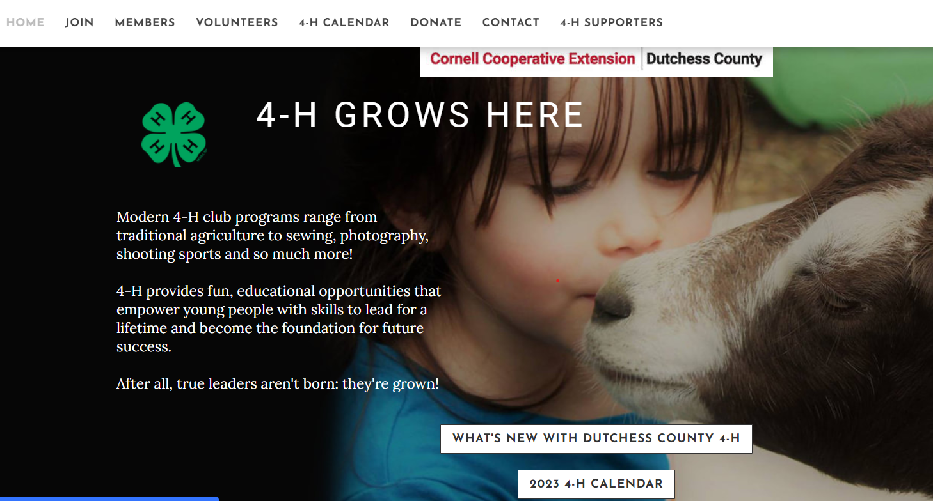
The 4-H Website Informs You
https://dutchesscounty4h.weebly.com/
Always look for information here before calling the office – we try to keep it up to date!

Slide 25
4-H Communicates with You
Please read the weekly emails from the 4-H office for:
Dates for upcoming 4-H events and activities
Deadlines for such as enrolment and presentations
Opportunities through 4-H at District and State
Opportunities beyond 4-H in the community
You MUST be fully enrolled to be in our database and receive these emails
Email: swb93@cornell.edu if you need help enrolling

Slide 26
You Communicate with 4-H
Help us to help you!
To do our jobs effectively, we need to know what is happening related to the programs and clubs. Please contact a 4-H staff member in a timely manner for such as:
Information you need
Changes in membership (kids come and go!)
Issues within the club
Activities you want to do (e.g., fundraisers, trips)
And please send us photos and write-ups for publicity so we can give the kids the kudos they earn!

Slide 27
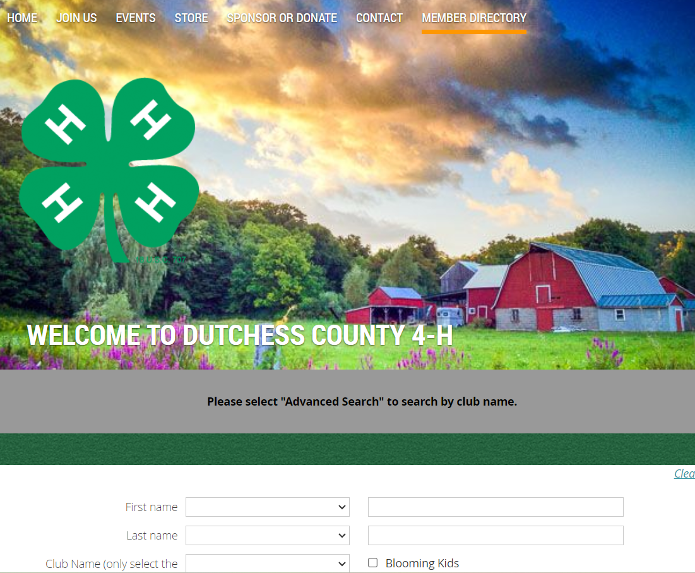
Know your Members
As Club Leaders, you can log into your membership account in Wild Apricot and see who is enrolled in your club.
If members names do not appear, contact the 4-H office.
If names of youth not in your club appear, let us know.

Slide 28
Communicate with your Members
You are the Glue!
Without notifications and reminders from you to your members your club cannot function effectively.
Establish and publish meeting dates, times and venues at the start of the year
Send reminders and update families on changes in a timely fashion
Ensure all families know about 4-H dates, deadlines and opportunities
Steer them to the 4-H website and encourage them to read weekly emails and help themselves!

Slide 29
Club Operating Guidelines
The next slides contain a brief overview of the essential information needed to start and run a successful 4-H Club
Reach out to the 4-H staff if you cannot find the answers you need on the website.

Slide 30
The 4-H Year
The 4-H years starts October 1 and ends on September 30 of the following year.
Clubs can start at any time but must be active by April 1 (half-way through the year) for members to exhibit projects at the Dutchess County Fair
Returning members must enroll by January 1 to exhibit projects at the Dutchess County Fair
New members must enroll by April 1 to exhibit projects at the Dutchess County Fair

Slide 31
4-H Age Rule
The age rule is administered by NYS 4-H
4-H’ers are aged from 5 through 18 years as of January 1 of the 4-H year:
e.g., a child who is 4 in October but turns 5 before January 1 can enroll as a Cloverbud
e.g., a teen who is 18 in October but turns 19 before January 1st is not eligible to enroll
Children 5-7 years are called Cloverbuds and those 8 and over are called 4-H members

Slide 32
4-H Club Format
A club needs to have a minimum of 5 members (no maximum!)
New clubs must start before April 1st for members to be eligible to exhibit at the Fair
Clubs must hold at least 6 business meetings through the year, plus educational and fun activities, community service and fundraisers, public presentations and keeping record books

Slide 33
4-H Leader Obligations
Enrollment paperwork must be completed; volunteers must maintain a current Wild Apricot membership account
Every enrolled volunteer must be background checked and complete the CCE sexual harassment training
To drive for CCEDC (age 21 and over) pre-authorization through the LENS program is required
Leaders must attend two ‘Leader Forums’ (spring and fall) for program updates, training, and feedback
Volunteers must abide by the Code of Conduct
Volunteers must comply with program requirements

Slide 34
4-H ‘Paperwork’
The good news: there is much less of this than in the past, and much is online. The bad news: there is still some to do!
At least once per month, leaders should access the Membership Directory and ensure it accurately shows the members who attend meetings
A ‘Tri-annual Club Report’ must be submitted on time to update staff on the status and activities of the club
Other paperwork may be related to events such as Request to Fundraise and event entries
Clubs need bylaws (ask for a template). Members should agree these each October. Please give the office a copy.

Slide 35
4-H Membership
Leaders can set reasonable parameters, e.g., the maximum membership they can accommodate, the age range, and other considerations such as the need for resources
Clubs should set advance meeting dates that work for a majority of members; this may result in some youth being unable to join
Clubs cannot refuse membership on any basis not stated above and may never discriminate
All reasonable accommodations must be made to include youth with special needs

Slide 36
4-H’ers “In Good Standing”
The term “in good standing” is used for a member who has fulfilled all the requirements of the program:
Completed enrollment by the published deadline
Met the requirements stated in the club bylaws (e.g., attendance to meetings and activities, fundraising)
Abided by the 4-H Code of Conduct
Engaged in at least 2 hours of club Community Service
Completed a Public Presentation by the deadline
Submitted completed Project Books and Personal Development Records (book form or online survey)
Note: failing to do any of the above may jeopardize future membership in 4-H

Slide 37
4-H Club Operation
Club members do as much as possible towards running their club (depending on ages and abilities):
Choose their club name
Run their own meetings with elected officers
Choose activities
Arrange events such as community service (mandatory for each club) and fundraisers
Leaders (adults) should encourage, guide and facilitate but not dictate

Slide 38
4-H Club Business Meetings
Business Meetings (6+ per year), run (loosely) according to Roberts Rules of Order. The kids elect the following positions and fulfil the roles:
President
Vice president
Treasurer
Secretary
Other positions as required, e.g., publicity
They should take minutes and keep records (with support from the Leader(s) and parents)

Slide 39
4-H Activities
There is a list of activities that our insurers do not allow. Contact the 4-H office if considering anything out of the ordinary, and for any overnight trips
Usual activities include:
Club business meetings to set goals and plan activities
Educational sessions to teach project skills
Community service (mandatory each year)
Fundraising for things the club needs or wants to do
Social events and trips
https://dutchesscounty4h.weebly.com/general-member-info.html

Slide 40
4-H Treasury
4-H Clubs can fundraiser to support their members and provide supplies and educational experiences
Rules governing fiscal matters come from Cornell
Clubs should not have more than $750 in funds
Up to $150 you can keep a ‘cash box’
Over $150 you should open a Club bank account
Contact the 4-H office as there are fixed procedures for opening a 4-H club bank account and you will need an EIS number that can only be obtained through CCEDC

Slide 41
4-H at Dutchess County Fair
For many 4-H’ers, exhibiting at the DCF is a highlight – the ‘capstone’ project of their year
4-H is about year long learning where kids develop life and leadership skills and project-based skills and knowledge so while fair can be a wonderful experience it is not for everyone and should not be the focus of the program
Fair entry is only an option for youth in good standing
Fair entries are handled by the Dutchess County Ag Society via their website and have a hard open/close date
The 4-H Fairbook, packed with information, comes out in May

Slide 42
4-H Do’s and Don’ts
So much information, regulations and rules!
4-H Staff are here to help
Do take time to read the resources we provide and access the website. Most of what you need to know is there
Don’t hesitate to reach out and confirm with staff that you have your facts right and the activities you are doing are 4-H appropriate
Don’t panic – it soon becomes second nature and you will get out just as much as you put in or more
Do know that your efforts change lives for the better

Slide 43
4-H Logo(s)
The CCEDC logo, along with a 4-H logo if relevant, should be on all printed materials associated with CCEDC. The logo must not be covered by any other graphics.
Notes:
Your volunteer coordinator will discuss marketing needs when you are preparing for programs or events.

Slide 44
INCLUSIVE WELCOMING EQUITABLE SAFE
No person shall be denied admission to any educational program or activity or be denied employment (with CCE) on the basis of any legally prohibited discrimination involving, but not limited to, such factors as race, color, religion, political beliefs, national or ethnic origin, gender, sexual orientation, age, marital or family status, veteran status, or disability.
CCE is an Equal Opportunity Employer and Program Provider and invites all those with special needs to contact us regarding those needs that we may arrange for services.

Slide 45
4-H is for ALL Young People
Here in Dutchess County, we have a Zero Tolerance policy towards any form of discrimination, bullying or harassment.

Slide 46
All CCEDC Materials must contain the following statement:
“CCE provides equal program and employment opportunities. The programs provided by this agency are partially funded by monies received from the County of Dutchess. Please contact the Cornell Cooperative Extension Dutchess County office if you have any special needs”.
Notes:
This is a shorter version of the statement and it must appear on all printed materials.
As this needs to be on all documentation that is seen by the public eye so does our…. Flip to next slide (LOGO)

Slide 47
Where to get Information
https://ccedutchess.org/ (CCEDC)
https://dutchesscounty4h.weebly.com/ (CCEDC 4-H)
https://cals.cornell.edu/cornell-cooperative-extension (NYS CCE)
https://cals.cornell.edu/kelly-campbell (NYS CCE Volunteer Coordinator)
https://volunteers.cce.cornell.edu/ (CCE Volunteer Resources)
https://4-h.org/ (National 4-H website)
Notes:
Refer to the list in their packet of other Extension offices in New York.
We also have a reference list of all of the state Extensions if they need it.

Slide 48
Questions Welcome.
Email: Jane Rodd
Thank you for your time!

