Slide 1
CCEDC Fall Leaders Forum
October 2023

Slide 2
Fall 4-H Leader Forum Topics
Welcome Savanna
Highlights of 2022-2023 4-H Year
Review of the Fair
Dates for 2023-24
The 4-H Experience
Membership and Enrollment
Volunteer Requirements
Club-related Requirements
Sponsorship fees and terms
A-Fair to Remember Brainstorm

Slide 3
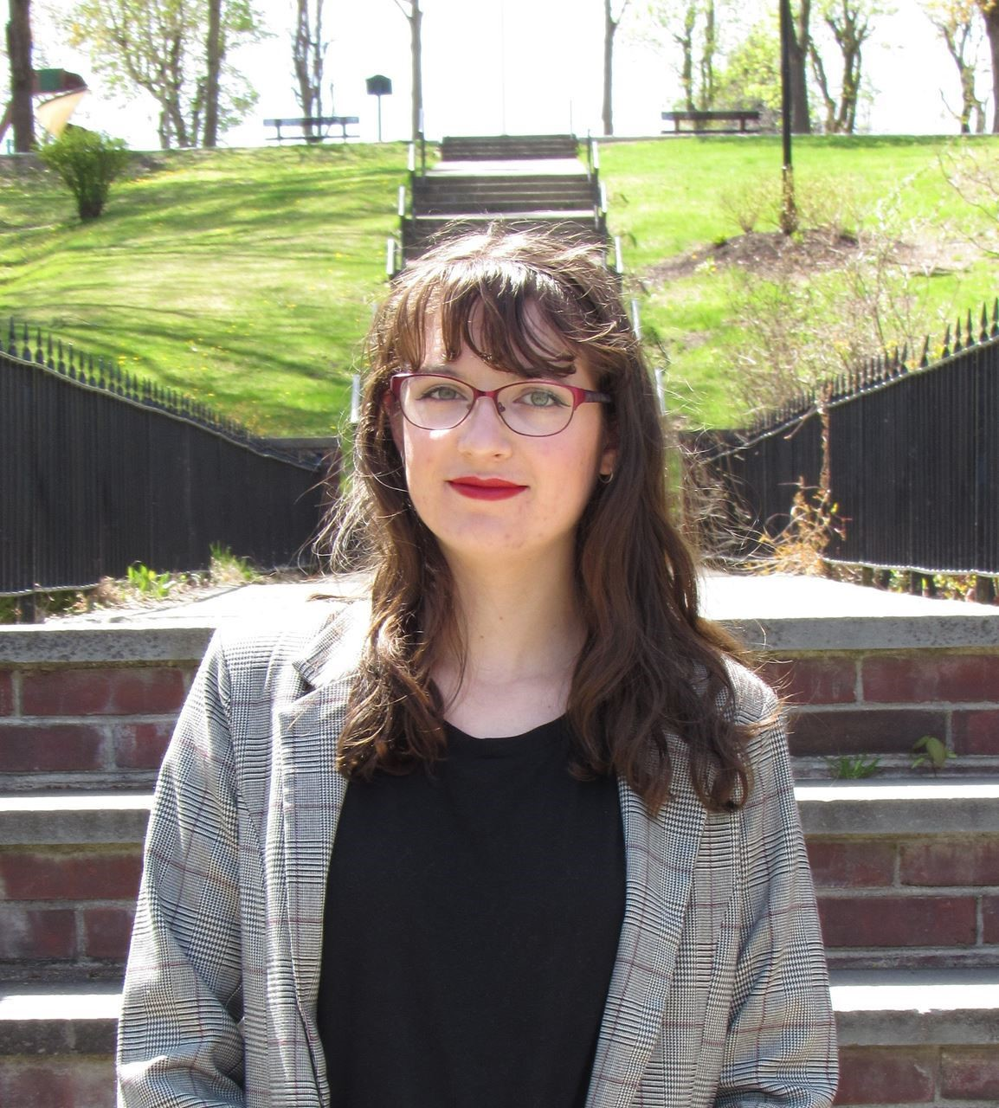
Savanna Burke: 4-H Program Co-ordinator
Savanna says: “I am very excited to be working with all of you! I’m an avid disc golfer, a knitter, and enjoyer of history. I’m currently living in Wappinger’s Falls, but I am a Salt Point native. Please feel free to reach me in the following ways: Email: swb93@cornell.edu 4-H Cell Number: 845-874-2388 Membership and enrollment Book rooms General 4-H info. Events and short programs

Slide 4
HIGHLIGHTS
Clubs and Projects
Public Presentations
Short programs and opportunities
Dutchess County Fair
Scholarships
Flourishing Farmers
After School
A-Fair to Remember

Slide 5
Review of the Fair
Photo Booth
Dorms
Cafeteria
Barn Bash and Awards
Exhibit Hall
Livestock Shows

Slide 6
2023-2024 Calendar
https://dutchesscounty4h.weebly.com/4-h-calendar.html

Slide 7
CREATING THE BEST 4-H EXPERIENCE
What makes a good 4-H experience???
Safe
Fun
Educational
Supportive
Resources:
https://nys4h.org/volunteer
https://www.nys4-h.org/

Slide 8
Membership and Enrollment
Interest from perspective members
How a waitlist might work
Re-enrolling member deadline: January 1, 2024
Can enroll after but $50 late fee and not fair-eligible
New member deadline: April 1, 2024
Can enroll if clubs want to accept them but not fair-eligible
Independent members or projects:
Not offering new opportunities if there is a club(s) with space available

Slide 9
Volunteer Personal Requirements
Enroll as Leaders or Volunteers (dedicated email)
Code of Conduct and releases
Sexual Harassment Training
Background checks (every 3 years)
MVR checks if needed
Responsive and Communicative
Meet 4-H Expectations

Slide 10
Club-Related Requirements
Insurance and Attendance: Enrollment
Meeting Venues (MUST book rooms ahead at CCEDC)
6 Business Meetings and Education
Community Service
Public Presentations (food presentations)
Record Books (survey in 2024)
Tri-annual Club Report

Slide 11
Sponsoring/Leasing Animals
Expectations for youth and families
Pros and cons of charging fees
Opportunities for kids who can’t lease
Developing a cross-program policy

Slide 12
THE 4-H A-FAIR TO REMEMBER
Expenses paid from this fund include:
Awards and prizes
Supplies and equipment
All printing, postage and other admin. costs
Volunteer expenses
State Fair expenses
Some staffing and travel
Tickets for low income and immigrant youth
Net Income
$22,106

Slide 13
2024 A-FAIR TO REMEMBER
Proposal:
A showcase of 4-H and ‘country fair’ type event open to the public with displays, demos, food trucks, farm stands, and other ag/county-based activities.
BRIANSTORM??????

Slide 14
Other Business and Questions
October 2023

Slide 15
Sexual Harassment Training
Extension Administration has made the CCE Sexual Harassment Prevention Training mandatory for all CCE enrolled volunteers. Please maintain proof of attendance.
Required training page online
Watch the 10-minute video
Confirm participation and understanding of the expectation
Communicate with their local CCE staff contact about completion (forward the completion email confirmation)
Report any Sexual Harassment witnessed, experienced, or perceived

